Slide 1

Exploration of Intrinsic Disorder Regions through Classification of Intrinsically Disordered Proteins Using PPI Network Structure and Sequence Attributes: A Case Study
Milana Grbić, Milan Predojević, Nenad Vilendečić, Dragan Matić
Faculty of Natural Science and Mathematics, University of Banja Luka
Belgrade Bioinformatics Conference 2024, Belgrade, Serbia,
June 17-21, 2024

Slide 2
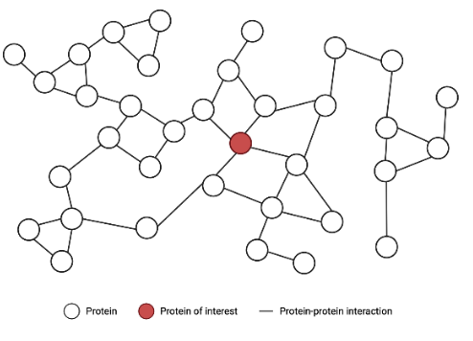
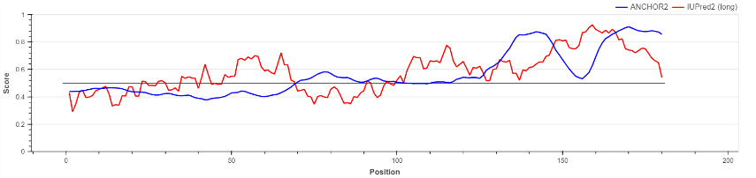
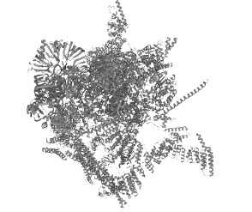
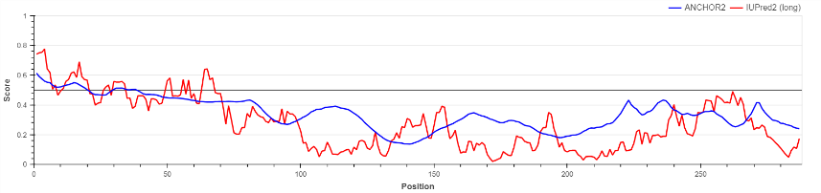
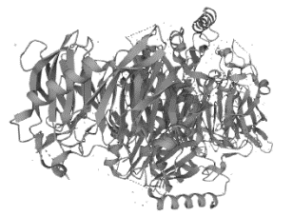
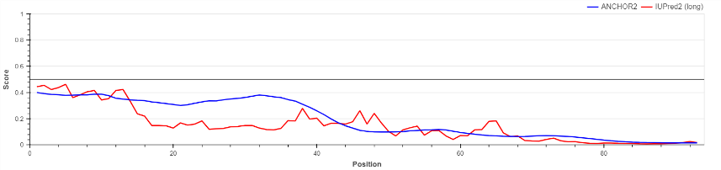
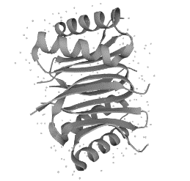
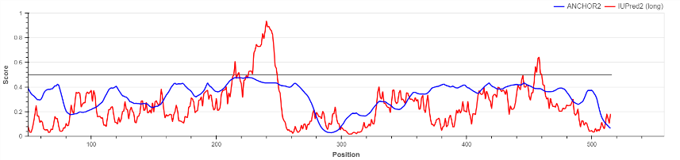
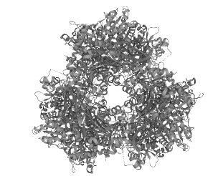
BioGRID Yeast network
128 features obtained by node2vec+
IDP classification based on features from weighted PPI network and protein sequences;
1.6
1.6
1.6
0.9
<YDR143C, v_{1,1},v_{1,2},…,v_{1,128}>
...
<YMR207C, v_{n,1},v_{n,2},…,v_{n,128}>
0.4
3.5
2.5
1.1
1.1
1.1
0.27
0.12
3.5
0.33
0.21
0.21
1.4
60 features extracted from protein sequences
0.5
<YDR143C, a_{1,1},…a_{1,10}, ba_{1,1},..., ba_{1,10},…,be_{1,1},…,be_{1,10}>
...
<YMR207C, a_{n,1},…a_{n,10}, ba_{n,1},..., ba_{n,10},…,be_{n,1},…,be_{n,10} >
Picture from https://www.biorender.com/template/protein-protein-interaction-ppi-network
MSESGQEQNRGTNTSPNNAENNNNSNAASGPLNGGAEQTRNITVSIQYSYFTPERLAHLSNISNND…
MMNPHVQENLQAIHNALSNFDTSFLSEDEEDYCPLCIEPMDITDKNFFPCPCGYQICQFCYNNIRQN…
Missclasiffied proteins, NAJAVITI TABELU
Protein | IUPred2A | Function | Structure | Location
YNL245C |  | Involved in pre-mRNA splicing. |  | Nucleus
YDL201W |  | Methyltransferase that catalyzes the formation of N7-methylguanine at position 46 (m7G46) in tRNA, a modification required to maintain stability of tRNAs; |  | Nucleus
YDR424C |  | Acts as a non-catalytic accessory component of the cytoplasmic dynein complex, involved in linking dynein to cargos and adapter proteins. |  | Cytoplasm, cytoskeleton Nucleus
YKL103C |  | Resident vacuolar enzyme that catalyzes the removal of amino acids from the N-terminus of peptides and proteins. |  | Vacuole

